Slide 1

Hate Speech Detection: Exploratory Data Analysis & Model Recommendation
Riya Gaur
Feb 16

Slide 2
Individual Project rheagaur12@gmail.com Drexel university NLP

Slide 3
I. Social media platforms contain harmful content in the form of hate speech. II. Objective: Develop an NLP-based model to detect and classify hate speech in tweets. III. Challenges: Large volume of unstructured text data. Presence of abbreviations, slang, and special characters. Imbalanced dataset (more non-hate speech than hate speech).
PROBLEM DESCRIPTION

Slide 4
1. Dataset Used: train_E6oV3lV.csv 2. Total Records: 31,962 tweets 3. Columns: id: Unique identifier label: (0 = Non-Hate Speech, 1 = Hate Speech) tweet: Original text content
DATASET OVERVIEW

Slide 5
Key Findings: 1. Class Distribution: 92.98% of tweets are non-hate speech. 7.02% of tweets are hate speech (Imbalance Issue). 2. Tweet Length Distribution: Most tweets have 10-25 words. Some outliers have very long text, requiring cleaning.
EXPLORATORY DATA ANALYSIS (EDA)

Slide 6
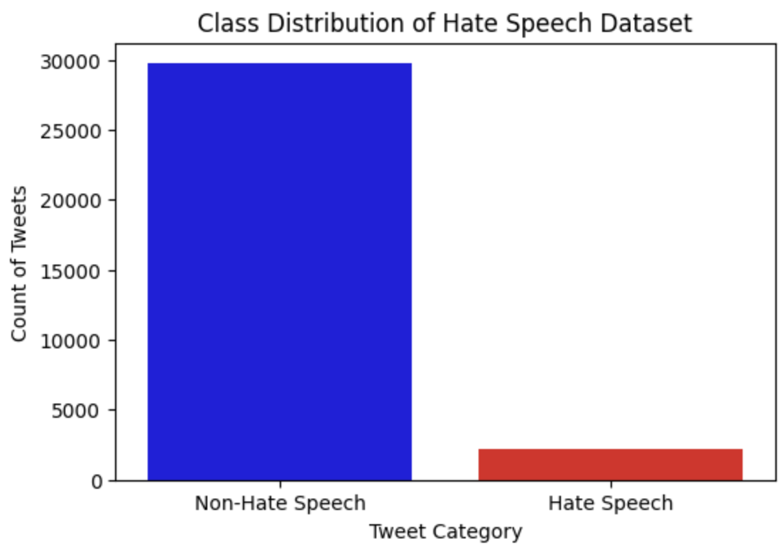
1. Non-Hate Speech (Majority) 2. Hate Speech (Minority, indicating class imbalance)
VISUALIZATION - CLASS DISTRIBUTION

Slide 7
1. Non-Hate Speech Tweets: Shows words like love, great, happy. 2. Hate Speech Tweets: Contains offensive words (filtered for ethical concerns).
WORD CLOUDS

Slide 8
1. Baseline Model: TF-IDF + Logistic Regression → Fast & interpretable. 2. Deep Learning Models: LSTM / BiLSTM → Captures sequential dependencies in text. BERT (Transformers) → Best for contextual understanding of hate speech. 3. Handling Class Imbalance: Use Oversampling (SMOTE) or class weight balancing.
MODEL RECOMMENDATIONS FOR TECHNICAL USERS

Slide 9
https://github.com/riyaagaur/Hate-Speech-Detection
GITHUB LINK

